Slide 1
Common Navigator Framework for Platform/UI in 3.2
Michael D. Elder
IBM Rational Software
Research Triangle Park, NC

Slide 2
Overview
Motivation and Background
Brief Demo of the Platform Project Explorer
  Instance of a Common Navigator
Tour of defining an extension and basic viewer
  Anatomy of a Navigator Content Extension
  Viewer definition and configuration
    Menu insertion points and drag transfer types
  Viewer behavior and data
    Content, Labels, Filters, Sorting, DND, and Actions
Closing remarks
Notes:
+ Describe the presentation flow
+

Slide 3
Comments on the Presentation
We are going to tour of each major piece of functionality
  I will try to highlight the important points
  Slides available on website for further study
Code snippets used to demonstrate important points for extenders
  Details can be referenced in the schema documentation for the extension points or the API documentation
Intend to generate awareness of what is possible
Request feedback on weaknesses or strengths of the solution
  Are there scenarios we did not consider that should be addressed in a viewer integration framework?
Notes:
+

Slide 4
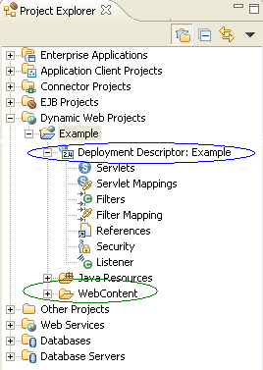
Problem Motivation: Use Case 1
Editor uses a custom document model with useful attributes that can be exposed to the user
Expose the document model in a navigator view
  The model in a navigator can be used to drive the editor
Commercial products repeat this pattern many times, exposing document models in a navigator view for many different editors
  Function teams do not want to create a custom navigator for each of these cases (leads to bad user experience, viewer “explosion”)
Requirement: Support a single viewer for all integrators

Slide 5
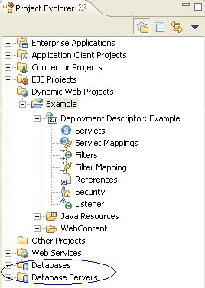
Problem Motivation: Use Case 2
Enhance UI with integration to other applications or data outside of the Workspace
  Example: WTP integration with Databases, Servers
  Could be handled with a viewer for each case (Problem: viewer “explosion” can overwhelm user)
Integration with a single viewer may expose too much for each individual user
Requirement: Allow non-resource driven model content
Requirement: All users to choose what they want to see in their integrated viewer

Slide 6
Problem Motivation: Use Case 3
Open Source Platform must allow integration from Commercial Products
Commercial Products may choose to allow tight integration with third-party contributions from Independent Service Vendors (ISVs)
Requirement: Allow Platforms to reuse a consistent viewer integration framework
  Allows commercial products to integrate contributions across platforms
  Consistent, public, documented API makes it easier for ISVs to contribute extensions to multiple commercial products

Slide 7
Review: Requirements from Use Cases
Support a single viewer for all integrators
All users to customize the content in their individual integrated viewer
Allow non-resource driven model content
Allow Platforms to reuse a consistent viewer integration framework
  Platforms (WTP, DTP) will expose their content for downstream reuse and allow integration with their viewers
  Commercial products may allow contributions from other Independent Service Vendors (ISVs) directly in their viewers or navigators

Slide 8
Goals of the Framework
Viewer Integration
  Provide infrastructure for contributors to integrate into a common viewer
Enhanced reusability
  Allow clients to reuse existing content and actions without significant effort and little or no code
  Clients should be able to define their own Common Navigator instances and “absorb” content easily (e.g. Resources, Java, etc)
Mitigate client reaction to upstream contributions from release to release

Slide 9
Background
Framework began as a product solution in Rational® Application Developer v6.0
  Derived from General Purpose Navigator proposal for Eclipse 3.0
  Good starting point; current version of framework completely new code
Migrated as part of the Web Tools Platform Initial contribution from IBM
Some API definition in WTP, but uncertainty as to the final home of the framework kept this effort minimal
Contributed to Platform/UI for 3.2 where it has undergone API finalization

Slide 10
Demo Platform Project Explorer
Resource, JavaTM and metamodel content
Turning extensions on and off
Sorting
Filters dialog
Menu actions
  Object contributions
  Action providers
  Dependent action providers
Drag and Drop

Slide 11
Common Navigator Extensions Included in Platform
Resource content for viewers
  Default filters from the Resource Navigator
  Menu options for New, Import, and Export resource wizards
  Basic resource actions (copy, paste, delete, etc)
Java content for viewers
  Default filters from the Package Explorer*
  Menu options for Java refactoring actions*
Project Explorer
  Id: “org.eclipse.ui.navigator.ProjectExplorer”
  Common Navigator instance for all clients to integrate with
*- In progress

Slide 12
Use Case for Talk
Define a Custom Viewer
Custom Viewer should expose resources and a custom metamodel
Metamodel will be driven from a properties file

Slide 13
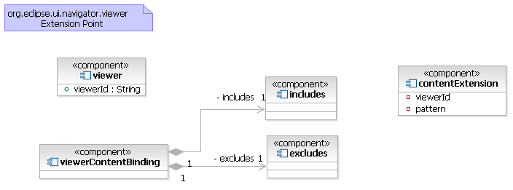
What Are We Going to Do?
Define a viewer

Slide 14
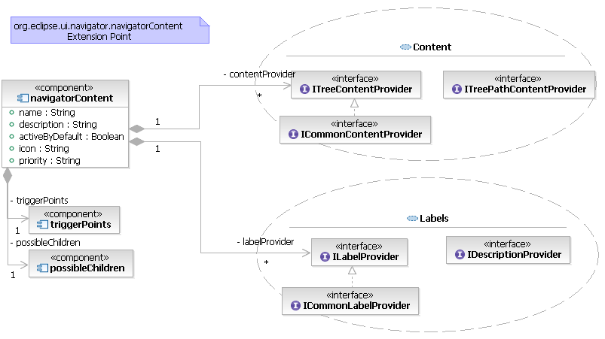
What Are We Going to Do?
Define a content extension

Slide 15
Creating a Common Navigator View Part
Define the viewer
  Creates the view part and makes it an extensible Common Navigator
Define the content extension
  Adds contents, labels, actions, etc
Define the binding to associate the content extension with the viewer
  Indicates that the content extension should be visible to the viewer
Notes:
+ The view part uses an API class from the framework – named CommonNavigator
+ Once defined, the view part requires configuration in the form of ..navigator.viewer
+ The content extension adds the meat of the viewer; the viewer is inherently extensible
+ The content (and actions) must be bound to the viewer

Slide 16
Extension Points
org.eclipse.ui.views
  Defines the view part
org.eclipse.ui.navigator.viewer
  Defines viewer configuration and properties on top of the view part
  Adds drag transfer types to viewers
  Binds content extensions and actions to specific viewers
org.eclipse.ui.navigator.navigatorContent
  Defines content extensions for the viewer
  Sorters
  Filters
  Drop assistants (DND)
  Action providers (menus + retargetable actions)
  Common Wizards

Slide 17
Example Viewer Definition
Define a simple viewer with a popup menu id
  <extension point=“org.eclipse.ui.views”>
  <view
  id=“org.acme.SimpleModelView”
  class=“org.eclipse.ui.navigator.CommonNavigator”
  allowMultiple=“false”
  name=“Simple Model Viewer” />
  </extension>
  <extension point=“org.eclipse.ui.navigator.viewer”>
  <viewer
  popupMenuId=
  “org.acme.SimpleModelView#PopupMenu”
  viewerId=“org.acme.SimpleModelView”>
  </viewer>
  </extension>

Slide 18
Tip: Configure Viewer Using options
Declarative options element allows clients to specify properties (see org.eclipse.ui.navigator.INavigatorViewerDescriptor)
  Hide the available extensions tab
  Hide the dialog
  Hide the link with editor and/or collapse all buttons
  Supply custom user properties
  See schema documentation for org.eclipse.ui.navigator.viewer (Examples)
Clients can provide their own properties to drive viewer customization
  INavigatorContentService.getViewerDescriptor()
  INavigatorViewerDescriptor.getStringConfigProperty()

Slide 19
What is a Content Extension?
Defines the meat of a contribution to add behavior and data to the viewer
Defines a content provider and label provider
  Cannot be contributed individually
Describes when the extension can provide children, parents, or labels with Eclipse Core Expressions
Describes associated Action Providers, Sorters, and Drop Assistants

Slide 20
How Advanced Can a Content Extension Be?
Content and label providers can tap into the memento associated with the viewer
  org.eclipse.ui.navigator.IMementoAware or ICommonContentProvider/ICommonLabelProvider
Label providers may provide descriptions for the status bar
  org.eclipse.ui.navigator.IDescriptionProvider
Label providers may also take advantage of custom fonts and labels
  org.eclipse.jface.viewers.IColorProvider
  org.eclipse.jface.viewers.IFontProvider

Slide 21
What Determines When an Extension Applies?
visibility
  An extension is visible to a content service if there is a viewerContent/ActionBinding for that content service that matches the id of the extension
active
  An extension is active if the extension defines the activeByDefault attribute as true, a client programmatically activates the extension, or the user turns the extension on through the “Available Extensions” dialog
enabled
  An extension is enabled for an element if the extension describes the element in its triggerPoints or possibleChildren expression
All states must be satisfied for a content extension to be invoked

Slide 22
Example Content Extension
Define an extension that can provide metamodel elements as children for IProjects
<extension point="...navigatorContent">
<navigatorContent
id="org...modelContent" <!-- id used for bindings -->
name=“Simple Model Contribution"
contentProvider="...ModelContentProvider"
labelProvider="...ModelLabelProvider"
activeByDefault="true“
priority=“normal">
<triggerPoints> <!-- describe possible parents -->
<or>
<adapt type="org...IProject"/>
<instanceof value="org...ModelTreeData"/>
</or>
</triggerPoints>
<possibleChildren> <!-- types of provided children -->
<instanceof value="org...ModelTreeData"/>
</possibleChildren>
<!-- could supply actions, sorters, dropAssistants -->
</navigatorContent>
</extension>
Tip: Drive model content from root of project or from the file that contains the data (see resource property testers)
Notes:
Resource Property Testers (org.eclipse.core.resources) define testers for things like file extension, name, project nature, etc for use in Eclipse Core Expressions.

Slide 23
Bind the Content Extension to the Viewer
Define the binding that will make the content extension visible to the content service of the particular id
Specifies the viewer id and a regular expression for the content extension
  Can select multiple extensions based on a pattern (such as “org.acme.content.*” to select all of “org.acme.content.modelA”, “org.acme.content.modelB”, etc)
Can specifically exclude extensions of a given id or pattern (“org.acme.content.tests”)
Clients can bind contributions to the Platform Project Explorer using the id “org.eclipse.ui.navigator.ProjectExplorer”

Slide 24
Example Viewer Content Binding
Define the viewer content binding to pick up our simple model extension, the resource extension and the available filters
  org.eclipse.ui.navigator.viewer: <viewerContentBinding />
<viewerContentBinding
viewerId="org.acme.SimpleModelView">
<includes>
<contentExtension
pattern="org...modelContent"/>
<contentExtension
pattern="org...navigator.resourceContent"/>
<contentExtension
pattern="org...model.filters.*"/>
<!-- pick up the resource filters for free -->
<contentExtension
pattern="org...resources.filters.*"/>
</includes>
</viewerContentBinding>
Tip: Be careful to use “contentExtension” and “actionExtension” under “viewerContentBinding” and “viewerActionBinding” respectively.

Slide 25
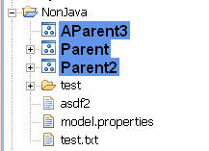
Result
Resource content and filters comes along for free
  We added this in our viewerContentBinding
Simple Model extension drives its metamodel from “model.properties” files in the root of the project
Simple Model extension uses custom label/fonts

Slide 26
Checkpoint
Covered the basics of
  defining a viewer,
  creating an extension, and
  binding the extension to the viewer
Will now focus on some advanced capabilities
End goal is for attendees to have a working knowledge of what is possible and where to go to add capabilities to their viewer

Slide 27
Advanced Capabilities
Action Providers
  Programmatic menu and retargetable action configuration
Sorters
Filters
  Programmatic
  Declarative
Drag and Drop
Common Wizard

Slide 28
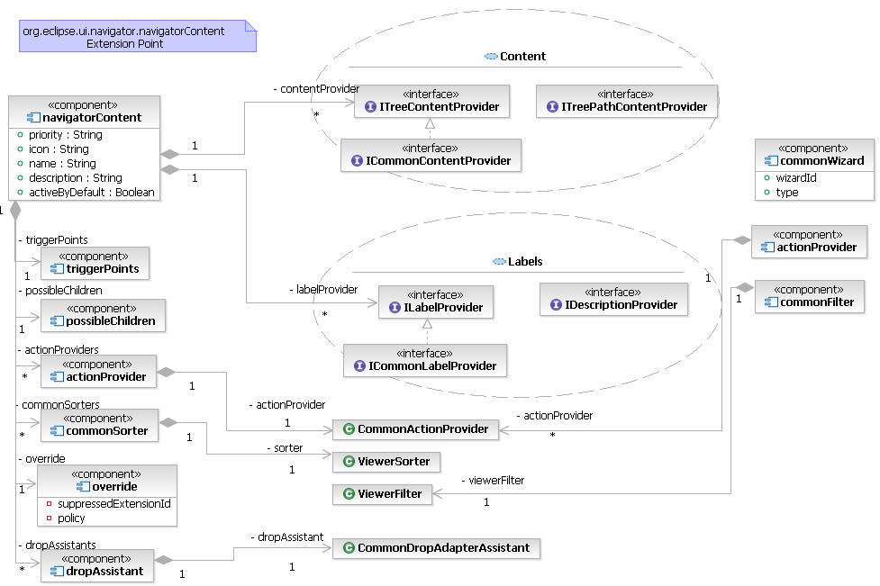
org.eclipse.ui.navigator.navigatorContent

Slide 29
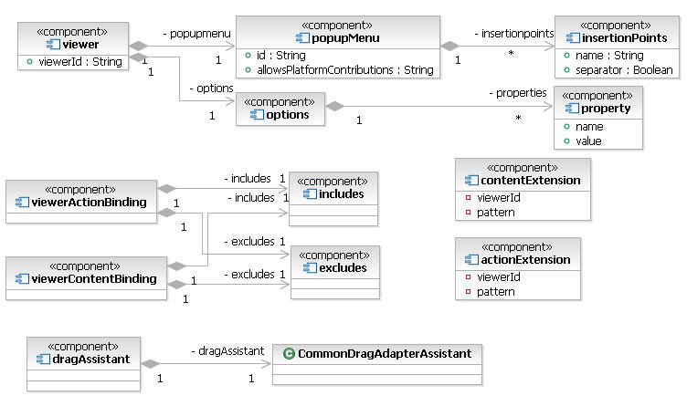
org.eclipse.ui.navigator.viewer

Slide 30
How Can I Configure Menus and Retargetable Actions?
Object Contributions
  org.eclipse.ui.popupMenus
  Viewer configuration allows contributions to be respected or ignored
Action Providers
  Programmatic control of menu configuration (add items dynamically based on selection)
  Allow clients to define retargetable actions for each selection change event (particularly the Open Action)
  Can either be defined as first-class contributions or associated with a specific content extension
  Can support dependencies so that if a required action provider is not enabled or invoked, its dependent action providers will not be queried

Slide 31
How Do I Associate Action Providers to Viewers?
Top-level action providers must be bound
  org.eclipse.ui.navigator.viewer: <viewerActionBinding />
Nested action providers (specified under a <navigatorContent />) extension inherit the binding from their containing content extension
  org.eclipse.ui.navigator.navigatorContent: <viewerContentBinding />

Slide 32
How Are Items from Different Contributions Sorted?
Consider the source of each item
If two items come from the same source, use the sorter enabled for their parent
If two items come from difference sources, use the relative priorities to sort them
If the relative priorities of the sources match, then sort the two items based on the label for each item (alphabetically)

Slide 33
How Can I Define Sorters?
Define as part of navigatorContent extension
  Associates the sorter with a specific content extension
  org.eclipse.ui.navigator.navigatorContent: <navigatorContent> / <commonSorter />
  <navigatorContent>
  ...
  <commonSorter
  class="org...ResourceExtensionSorter"
  id="org...defaultSorter">
  <parentExpression>
  <!–- expression to describe parents -->
  </parentExpression>
  </commonSorter>
  ...
  <navigatorContent>

Slide 34
How Can I Add Filters?
Filters can be contributed through extension points
  org.eclipse.ui.navigator.navigatorContent: <commonFilter />
  Not associated with any particular extension
  Bound to viewers with viewerContentBindings
Declarative filters can use core expressions
  Including the resource property testers (available in org.eclipse.core.resources)
  Core Expressions framework allows the definition of custom property testers (see org.eclipse.core.expressions)
Programmatic filters may subclass or reuse ViewerFilter

Slide 35
Example of Declarative and Programmatic Filters
Declarative – use core expression to describe filtered content
<commonFilter
id="org...filters.AllSimpleModelItems“
name=“Simple Model Items">
description="Hides all Simple Model Items“
<filterExpression>
<instanceof value="org...SimpleModelTreeData"/>
</filterExpression>
</commonFilter>
Programmatic – define a ViewerFilter that performs a calculation
<commonFilter
id="org...filters.SimpleModelItemsThatEndWith3”
name=“Simple Model Items that end with \”3\””
class="org...SimpleModelItemsThatEndIn3"
description="Hide Simple Model items that end in \”3\””
activeByDefault="true"
/>

Slide 36
How Are Filters Associated with a Viewer?
Use a viewerContentBinding with the viewer id and pattern of the filter ids
  org.eclipse.ui.navigator.viewer: <viewerContentBinding />
<viewerContentBinding
viewerId="org.acme.SimpleModelView">
<includes>
...
<contentExtension
pattern="org...navigator.filters.*"/>
<!-- pick up the resource filters for free -->
<contentExtension
pattern="org...resources.filters.*"/>
</includes>
</viewerContentBinding>

Slide 37
How Can I Extend DND for a Viewer?
Drop operations support LocalSelectionTransfer, FileTransfer, and PluginTransfer types
  LocalSelectionTransfer is in JFace, not IDE layer
Clients can add drop assistants for intra-viewer DND operations or use PluginTransfer to handle drop operations on other views
  PluginTransfer limited to same instance of Eclipse
Transfer types can be added for drag operations
  org.eclipse.ui.navigator.viewer: <dragAssistant/>
  ResourceDragAssistant can be reused for other viewer definitions (already available in the Project Explorer)

Slide 38
Common Wizard
Context sensitive wizard shortcut based on selection
Built to take advantage of org.eclipse.ui.XXXwizards extensions
Are not restricted by viewer bindings
  Feedback from the community could change this if necessary
Clients can add these to any menu using org.eclipse.ui.navigator.WizardActionGroup

Slide 39
Example Common Wizard Definition
Bind the wizard id from org.eclipse.ui.newWizards for the New File Wizard to show up for IProject, IFolder, and IFile
  org.eclipse.ui.navigator.navigatorContent: <commonWizard />
<commonWizard
type="new"
wizardId="org.eclipse.ui.wizards.new.file">
<enablement>
<or>
<adapt type="org.eclipse.core.resources.IFile" />
<adapt type="org.eclipse.core.resources.IFolder" />
<adapt type="org.eclipse.core.resources.IProject" />
</or>
</enablement>
</commonWizard>

Slide 40
I Need More Control!
Much of what is available declaratively can be controlled programmatically
  Extensions may be programmatically bound or activated/deactivated
Core framework driven from org.eclipse.ui.navigator.INavigatorContentService
  Can be reused outside of the org.eclipse.ui.navigator.CommonNavigator view part
Secondary services expose (via API) used by the viewer to handle things like filters, sorting, and DND

Slide 41
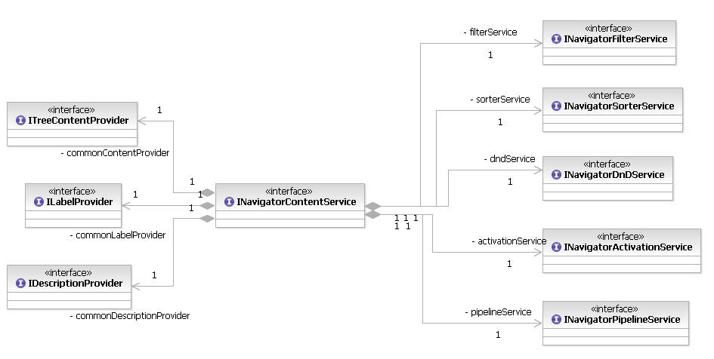
Common Navigator Services
Notes:
ContentProvider, LabelProvider, DescriptionProvider can be used anywhere by clients to tap into the extension framework.
All Services are tied to a Content Service, and are driven off of the visibility and activation settings of that specific instance.

Slide 42
Review and Cheatsheet
Defined basic viewer and extension
Discussed advanced capabilities including
  Viewer configuration (viewer: <viewer> / <options />) and bindings
  Content extensions (navigatorContent: <navigatorContent />)
  Action Providers (navigatorContent: <actionProvider /> or <navigatorContent> / <actionProvider/> )
  Sorters (navigatorContent: <navigatorContent> / <commonSorter />)
  DND (viewer: <dragAssistant />, navigatorContent: <dropAssistant/>)
  Filters (navigatorContent: <commonFilter />)
  Common Wizard (navigatorContent: <commonWizard />)

Slide 43
Closing Remarks
Common Navigator Framework provides a quick route to integrated viewers
Clients can define their own instances or tap into the instance provided by Platform
  (id: “org.eclipse.ui.navigator.ProjectExplorer”)
Designed to be RCP compliant
  No known RCP clients yet (so get started!)
Adopted by several Eclipse projects
  Web Tools Platform (WTP)
  Data Tools Platform (DTP)
  C/C++ Development Tools (CDT)

Slide 44
Acknowledgements
Saurabh Agarwal
Dirk Bäumer
Nick Edgar
Markus Keller
John Lanuti
Eric Moffatt
Michael Valenta
Michael Van Meekeren
Thanks!

Slide 45
Legal Notices
Rational is a trademark or registered trademark of International Business Machines Corp. in the United States, other countries, or both.
Java and all Java-based trademarks are trademarks of Sun Microsystems, Inc. in the United States, other countries, or both.
Other company, product, or service names may be trademarks or service marks of others.

